Slide 1
Linear Regression
-By Chitra Roy

Slide 2
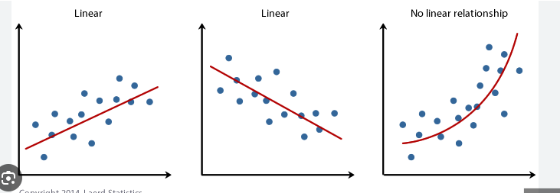
Introduction to Linear Regression
Linear regression is a type of supervised machine learning algorithm that computes the linear relationship between the dependent variable and one or more independent features by fitting a linear equation to observed data.

Slide 3
Advantages and Disadvantages
Regression
Advantages
Disadvantages
Easy to use for Prediction
Software available
Useful for Predicting and forecasting
Sensitive to outliers
Assumes a linear relationships
Large amount of required data to predict accurate results

Slide 4
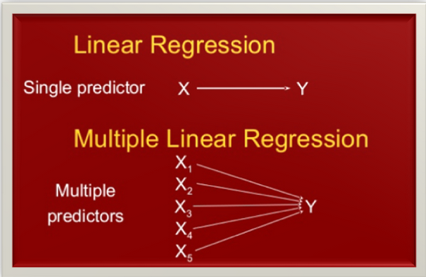
Types of Linear Regression
There are two main types of linear regression:
1) Simple linear regression
2) Multiple Linear Regression
y=β0​+β1​X
where:
Y is the dependent variable
X is the independent variable
β0 is the intercept
β1 is the slope
y=β0​+β1​X+β2​X+………βn​X
where:
Y is the dependent variable
X1, X2, …, Xp are the independent variables
β0 is the intercept
β1, β2, …, βn are the slopes

Slide 5
Assumptions of Linear Regression
Linearity: The relationship between the dependent and independent variables is linear.
Independence: Observations are independent of each other.
Homoscedasticity: The residuals (errors) have constant variance at all levels of x.
Normality: The residuals of the model are normally distributed.
No Multicollinearity: In multiple linear regression, the independent variables are not highly correlated with each other.

Slide 6
Thank you

